Slide 1

Major Project Title
Name:- Keshab Kumar
Apply ID: APPLY_172711308466f1a77c56a3d
Internship ID: INTERNSHIP_172663295366ea53f910591
AICTE ID:-STU64b68f7eda5591689685886
College:- NOIDA INSTITUTE OF ENGINEERING & TECHNOLOGY
Branch:- Computer Science and Engineering

Slide 2

PROBLEM STATEMENT
Conduct an in-depth analysis of a healthcare dataset to explore patterns related to illness, income, and health insurance. Key objectives include identifying duplicate records, demographic patterns of illness, gender-wise analysis of reduced activity, income-based health outcomes, and insurance coverage. Utilize visualization techniques to identify missing values, correlations, and the impact of income on hospital visits. Develop additional insights through exploratory and visual analysis.

Slide 3
Project Description
This project focuses on analyzing a healthcare dataset containing 5,190 records across 12 variables, representing various health, demographic, and economic aspects of individuals. The primary objective is to derive meaningful insights and actionable recommendations related to illness patterns, health insurance coverage, income, and gender-based disparities.
Key Analysis Areas:
General Data Insights:
Identify and quantify duplicate records.
Analyze the distribution and patterns in the dataset variables.
Illness and Demographics:
Examine the count of illnesses and their distribution across genders.
Investigate the number of days of reduced activity due to illness, categorized by gender.
Economic Impact:
Analyze the relationship between income levels and hospital visits.
Classify individuals based on income levels (maximum, minimum, and median).
Health Insurance Coverage:
Visualize the percentage of people receiving government health insurance due to low income or old age.
Calculate the percentage of individuals with private health insurance.
Correlations and Missing Data:
Use heatmaps to identify missing values and correlations between variables.
Pinpoint strongly correlated variables for deeper insights.
Health and Activity Analysis:
Examine the relationship between general health status and reduced activity days.
Visualize gender-based differences in reduced activity due to illness.
Additional Insights:
Explore any novel patterns or trends in the data that could provide value.
The findings will be supported by visualizations such as bar charts, heatmaps, and percentage distributions to communicate insights effectively. The analysis aims to enhance understanding of health-related behavior, economic disparities, and insurance coverage patterns.

Slide 4

WHO ARE THE END USERS?
Healthcare Providers:
Hospitals, clinics, and doctors can use insights to understand patterns in patient visits, illnesses, and activity reduction, enabling better resource allocation and care strategies.
Health Insurance Companies:
Insurance companies can analyze trends in health coverage (private and government) to design more inclusive policies and target underserved demographics.
Policy Makers and Government Agencies:
Insights about government health insurance beneficiaries can help refine policies for low-income and elderly populations.
Public Health Researchers:
Researchers can utilize the data to study the relationships between income, health status, and access to healthcare services.
Economists and Social Scientists:
Analyze the socioeconomic impacts of health conditions and insurance coverage for broader studies on public welfare and economic disparities.
General Public:
Individuals may benefit from publicized insights, encouraging proactive health management and awareness of available insurance options.
The project ultimately aims to assist stakeholders in improving healthcare delivery, designing better health policies, and reducing economic and social inequalities in health outcomes.

Slide 5

Technology Used
Python
Numpy
Seaborn
Pandas matplotlib
Jupyter Notebook
Git & GitHub

Slide 6
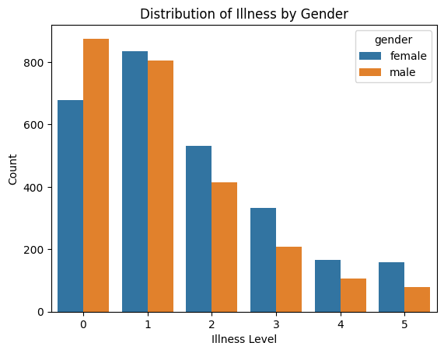
RESULTS

Slide 7
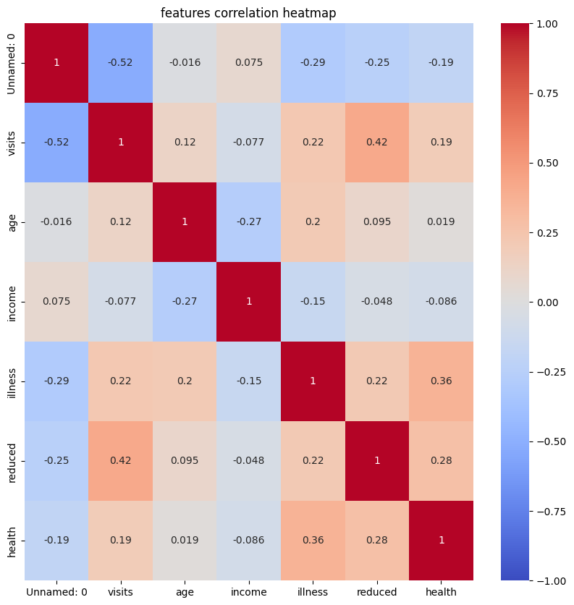
RESULTS

Slide 8
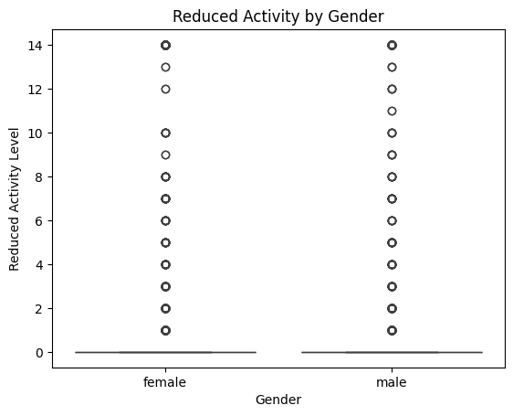
RESULTS
Demo Link

Slide 9
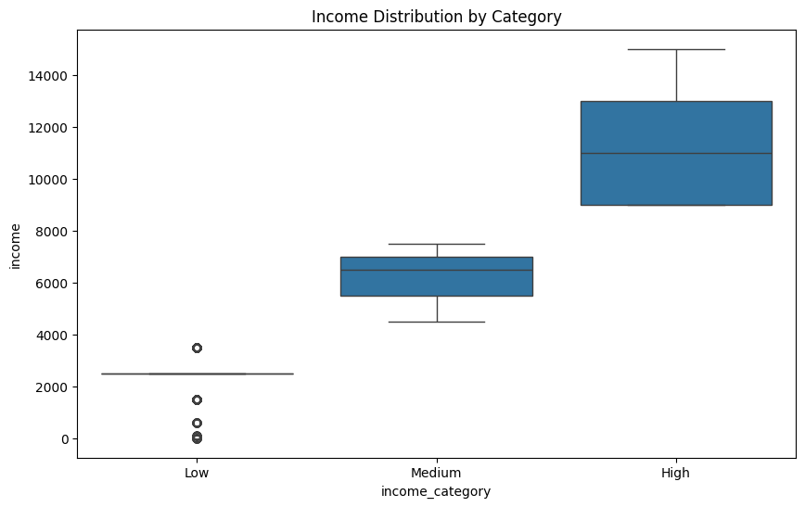
RESULTS
Demo Link

Slide 10
Thank you
.
.

